Slide 1
Experimental Assessment of Coastal Infrastructure Vulnerability
Brian M. Phillips
Assistant Professor
University of Maryland
Mpact Week: Disaster Resilience
A. James Clark School of Engineering
October 22, 2014

Slide 2
Introduction and
Motivation

Slide 3
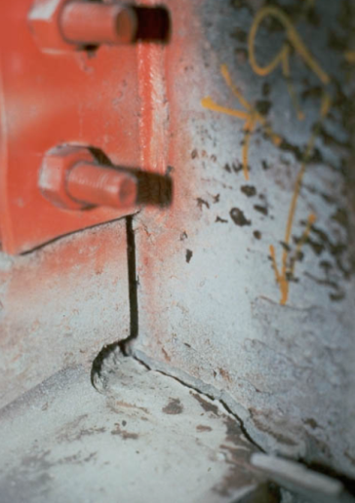
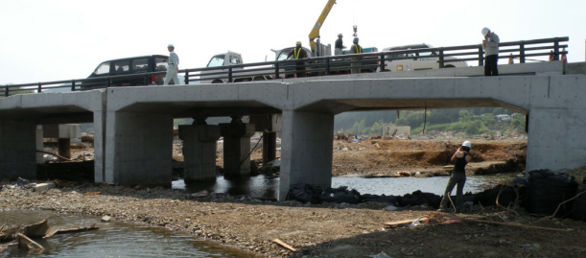
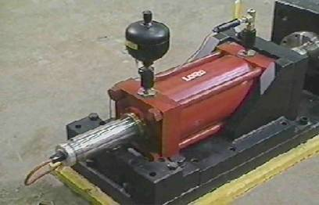
Experimental Testing
Experimental testing required when
  Response complex or not well understood
  Difficult to model numerically
  Models do not exist
Results lead to better
  Understanding of dynamic behavior
  Computational models and constitutive relationships
  Design methods and codes

Slide 4
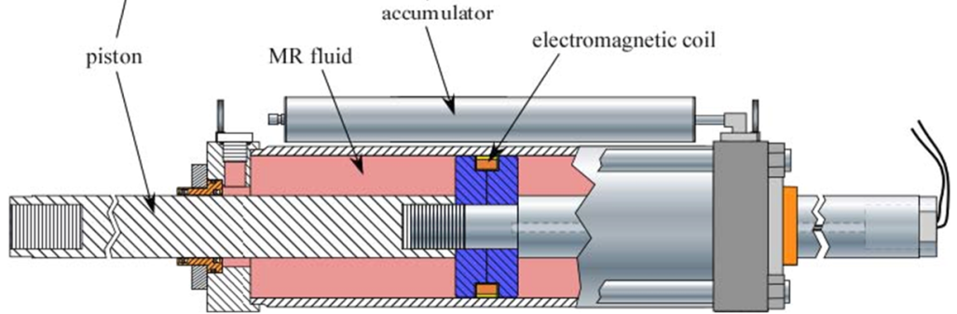
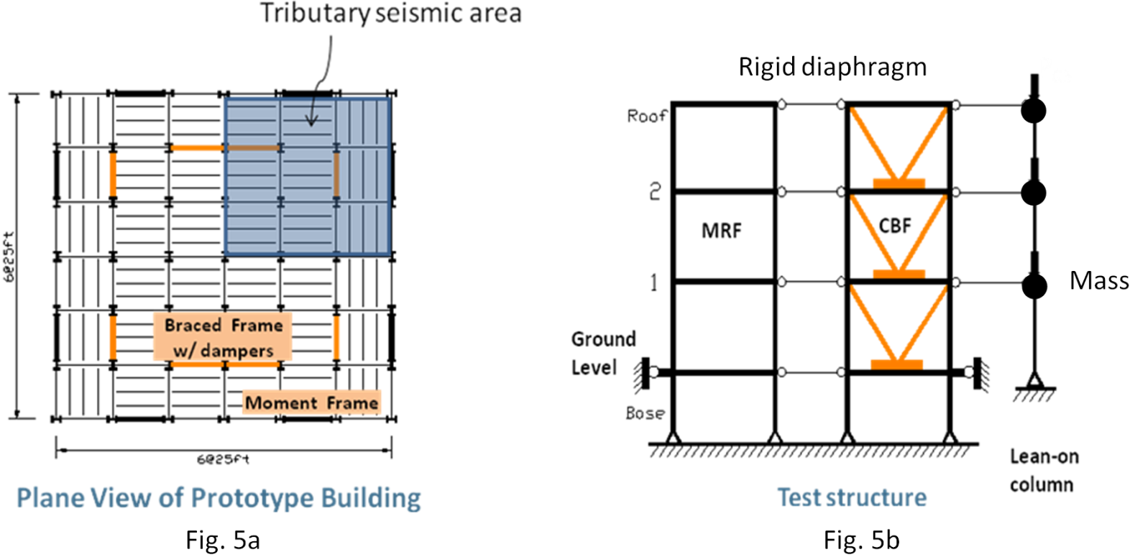
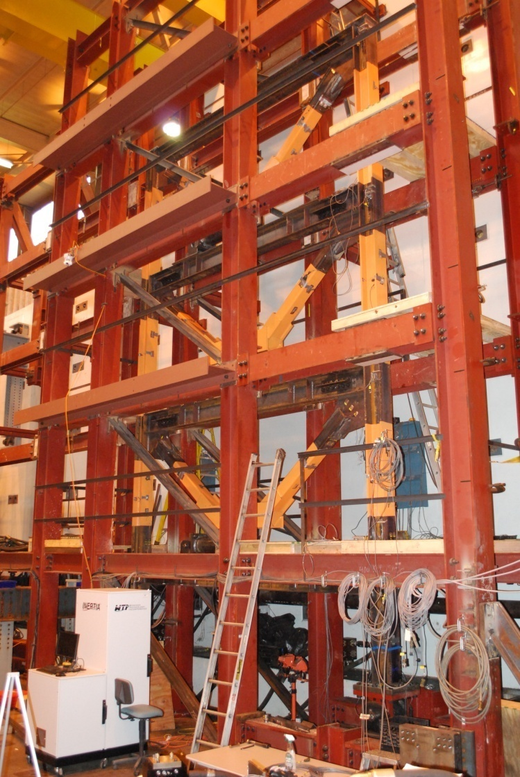
Advances through Recent Investments in Experimental Testing
Performance-based design and real-time, large-scale testing to enable implementation of advanced damping systems
-PI Shirley Dyke (Purdue)
Created high-fidelity numerical models
Developed structural control devices
and algorithms
Validated of performance based design
approach

Slide 5
Role of Experimental Testing in
Impact Assessment
S.L. Lin, J. Li, A. S. Elnashai, and B. F. Spencer (2012). “NEES Integrated Seismic Risk Assessment Framework (NISRAF),” Soil Dynamics and Earthquake Engineering, Vol. 42, pp. 219-228.

Slide 6
Experimental
Methods

Slide 7
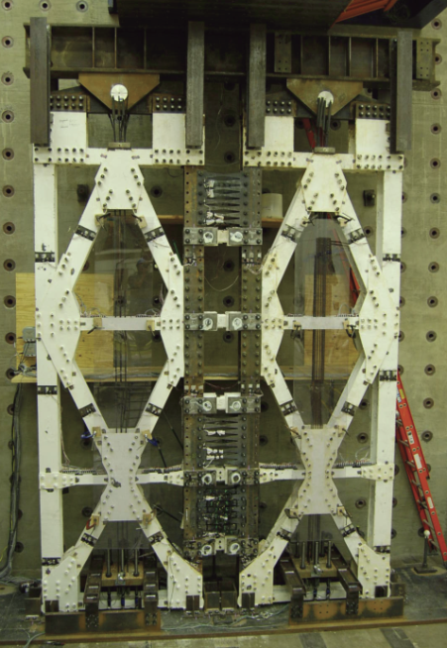
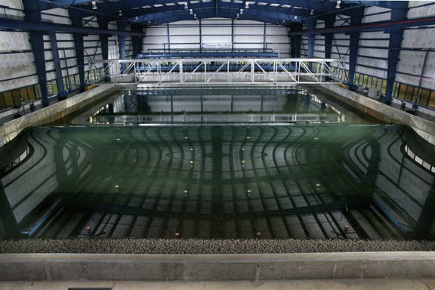
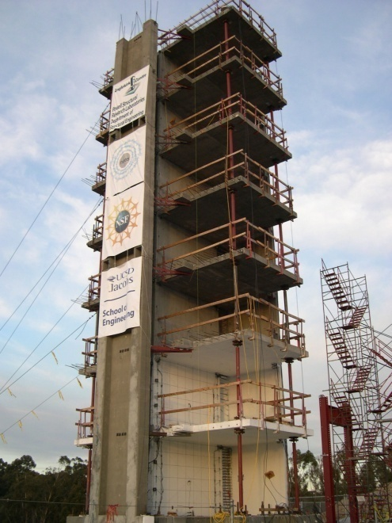
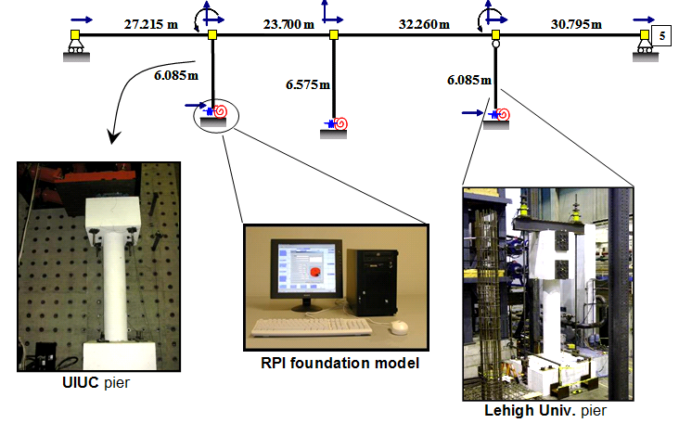
Experimental Methods
Quasi-Static Testing
Validate new components and materials
Wave
Tank
Study tsunami flow, impact, debris, and scour
Oregon State University
Tsunami Wave Basin
University of Illinois
Large-Scale Reaction Wall
Shake Table Testing
Study performance of structures under severe earthquake loads
Hybrid Simulation
Efficiently combine experimental testing and simulation
Univ. of California San Diego
Large-Scale Shake Table
Multi-Site NSF Project

Slide 8
Dynamic Testing Summary
Shake Table
Real-time
Hybrid Simulation
Effective Force
Testing
Experimental Input
Experimental Input
Experimental Input
Base acceleration
Story displacements
Story inertial forces
Numerical Simulation
Numerical Simulation
Numerical Simulation
Not required
Required
Not required
Dynamic Experiment
Dynamic Experiment
Dynamic Experiment
Yes
Yes
Yes
Substructuring
Substructuring
Substructuring
Not possible
Possible
Possible

Slide 9

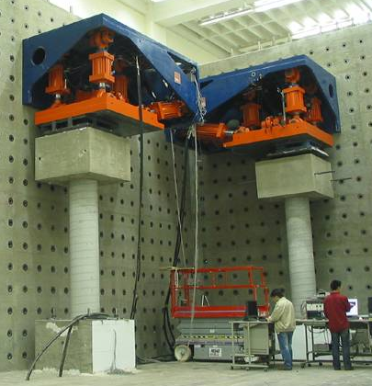
Substructuring
Structure of Interest
Actuators
Sensors
Numerical Substructure
Experimental Substructure

Slide 10
Coastal
Infrastructure
Experimental
Opportunities

Slide 11
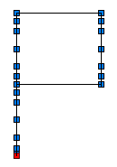
Coastal Infrastructure Experimental Studies
Numerical substructure
Wish list
  Substructuring
  Accurate, reproducible loading
  Use widely available equipment
Multi-physics
  Fluid-structure interaction
  Soil-structure interaction
  Impact forces
Challenges
  Complex boundary conditions
    Displacement compatibility
    Force equilibrium
m₂
x₂(t)
k₂
c₂
m₁
x₁(t)
k₁
c₁
Experimental substructure
Wind
Waves & Surge
Earthquakes
Flooding

Slide 12
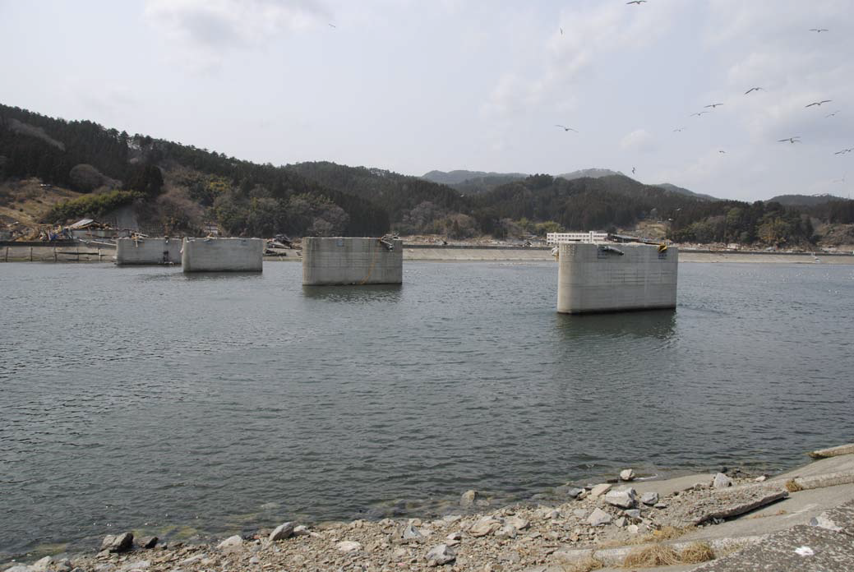
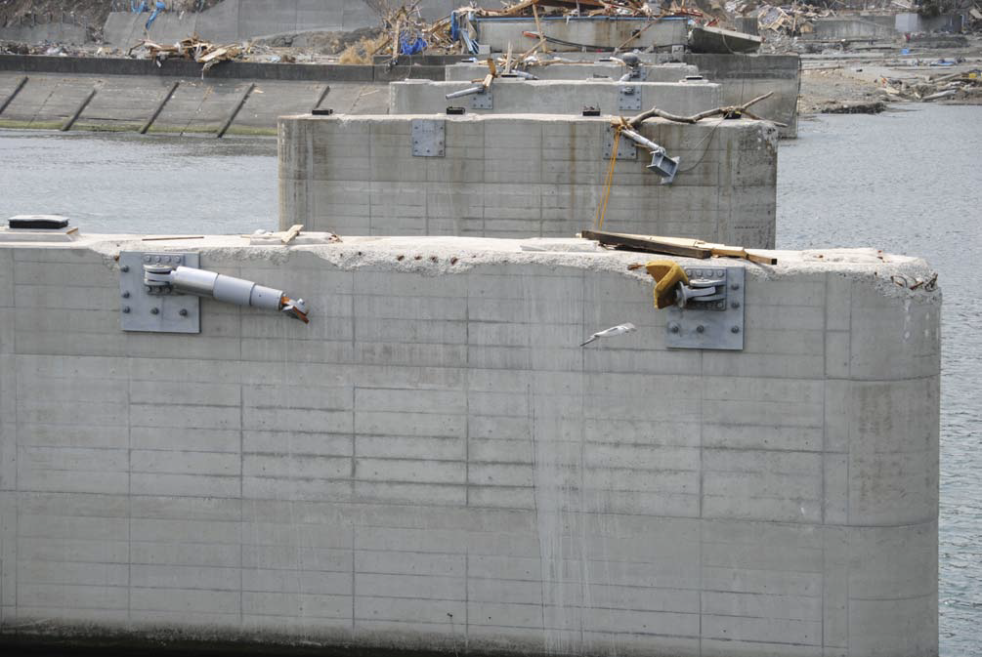

Bridge Deck Uplift
Kesen Bridge, Japan
2011 Tohoku Earthquake
and Tsunami
(Kawashima, 2011)
Fluid-structure interaction test
Gravity forces,
Hydrodynamic forces
FEM Model
Deck and hydrodynamic load
Specimen
Elastomeric bearing
Displacements

Slide 13
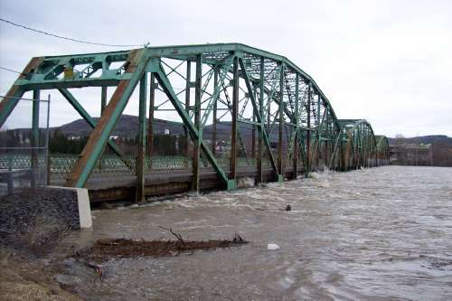
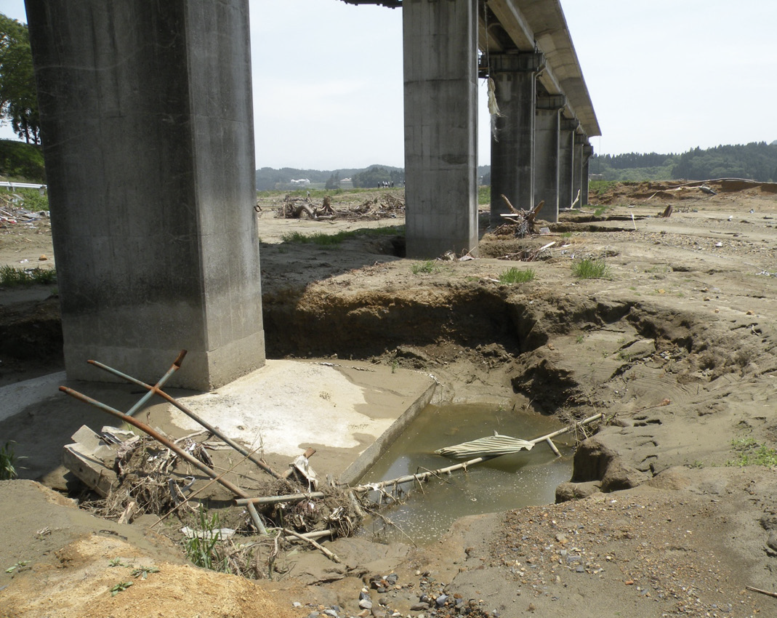

Saturated Soils and Scour
Koizumi Bridge, Japan
2011 Tohoku Earthquake
and Tsunami (EERI, 2011)
St. John River, Maine
2008 (USGS)
Fluid-soil-structure interaction test
Gravity forces,
Horizontal displacements
Flow
FEM Model
Bridge superstructure
Restoring forces
Soil
Specimen
Submerged pier

Slide 14
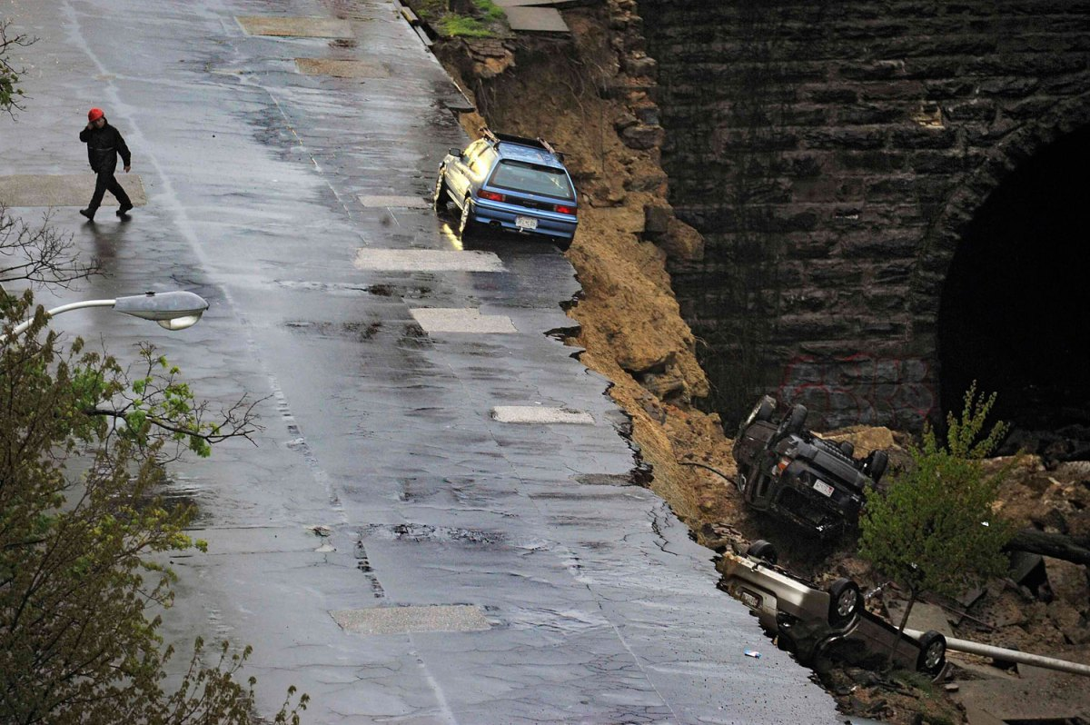
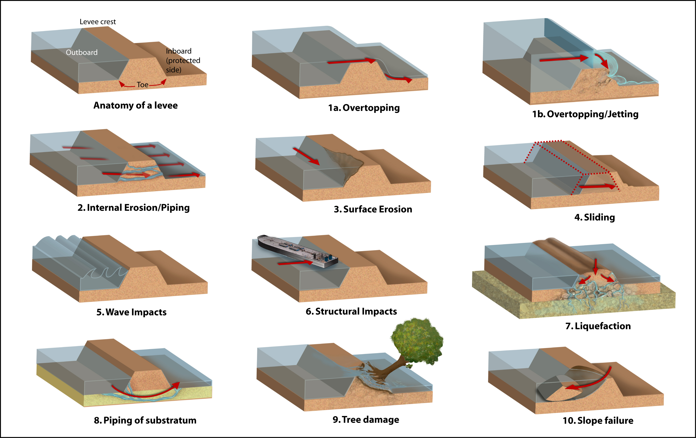

Dynamic Soil Pressure
Multiple failure
mechanisms of
New Orleans
levees (NSF)
East 26th Street, Baltimore
April 30th, 2014 (Reuters)
Soil-structure interaction test
Forces
Displacements
FEM Model
Soil, ground motion, and liquefaction
Specimen
Retaining wall

Slide 15
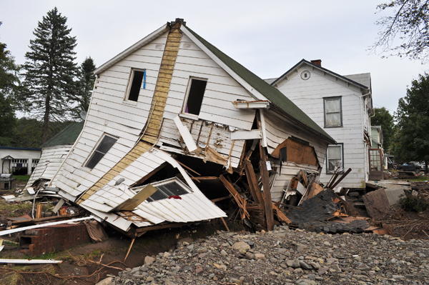
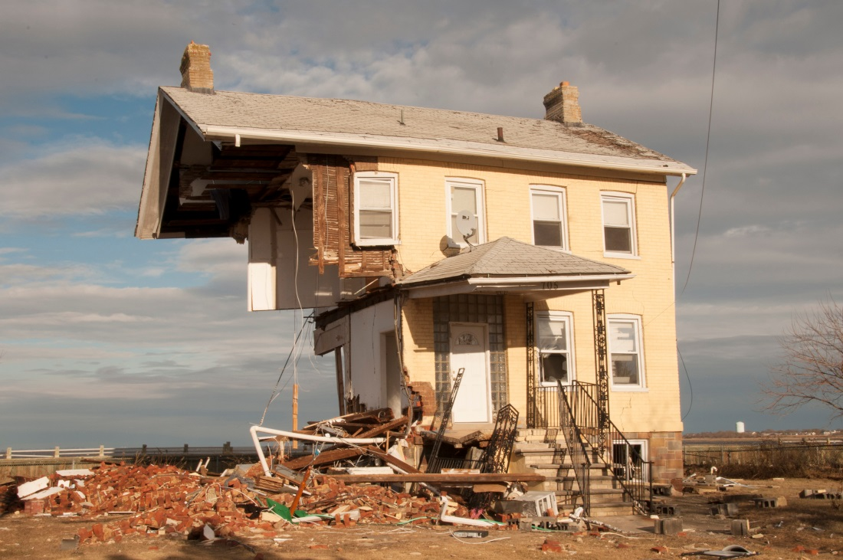
Hurricane Forces
Prattsville, NY
2011 Hurricane Irene
(FEMA)
Union Beach, NJ
2012 Hurricane Sandy
(FEMA)
Fluid-structure interaction test
Wind forces
Displacements
FEM model
Building frame and hurricane winds
Specimen
Wind resisting system

Slide 16
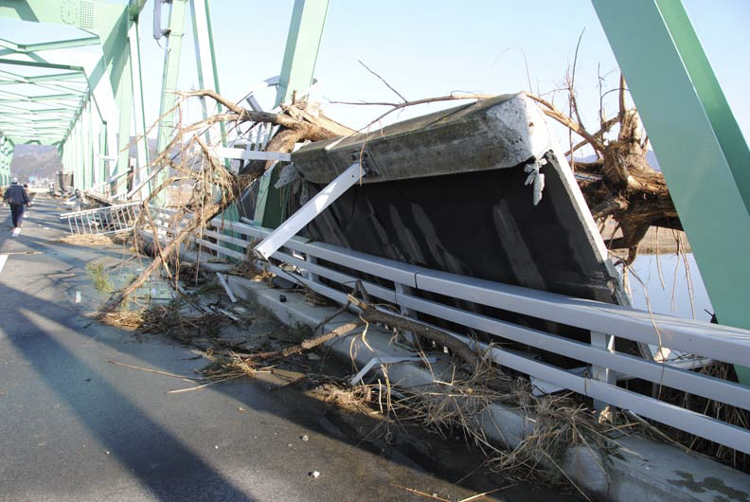
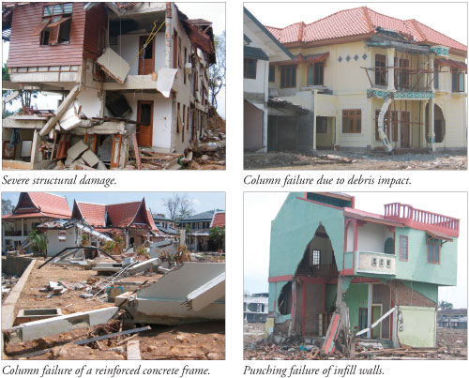
Tsunami and Debris Impact
Shin-Kitakami Bridge, Japan
2011 Tohoku Earthquake
and Tsunami
(Kawashima, 2011)
2004 Indian
Ocean Tsunami
(Palermo and
Nistor, 2008)
Fluid-debris-structure interaction test
Tsunami forces,
Impact forces
Accelerations
Forces
Displacements
FEM Model
Upper stories
FEM Model
Tsunami simulation
Specimen
Moment resisting system

Slide 17
Conclusions

Slide 18
Conclusions
Experimental testing has produced a revolution in earthquake engineering design and practice.
Newly developed experimental testing techniques enable a wealth of studies for a similar revolution in coastal engineering.
  Multi-hazard testing
  Substructuring
  Dynamic force and displacement boundary conditions
  Direct force-based loads to specimens
  Highly interdisciplinary
Flooding
Earthquakes
Waves & Surge
Wind

Slide 19
Thank you for your attention
References
EERI (2011). “Geotechnical Effects of the Mw 9.0 Tohoku, Japan, Earthquake of March 11, 2011.” EERI Special Earthquake Report, September, 2011.
Kawashima, K. (2011). “Damage of Bridges Resulted from March 11, 2011 East-Japan Earthquake”, Preliminary disaster survey, April 15.
Palermo, D. and Nistor, I. (2008). “Tsunami-Induced Loading on Structures”, Structure, NCSEA/CASE/SEI, March.
Lin, S.L., Li, J., Elnashai, A.S., and Spencer Jr., B.F. (2012). “NEES Integrated Seismic Risk Assessment Framework (NISRAF),” Soil Dynamics and Earthquake Engineering, Vol. 42, pp. 219-228.

