Slide 1
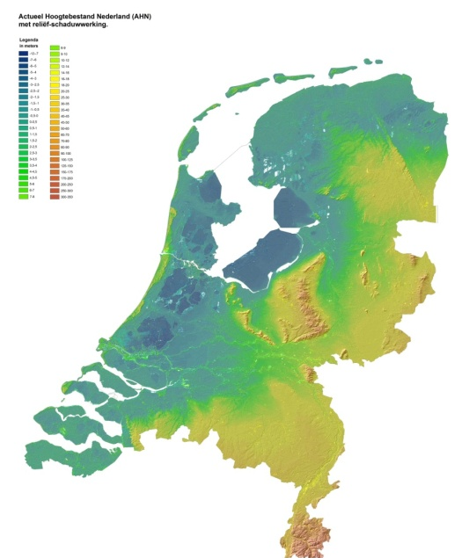
THE DUTCH DELTA MODEL FOR POLICY ANALYSIS ON LONG TERM WATER MANAGEMENT
IN THE
NETHERLANDS
Relief map: deep blue is below sea level
Dr. Lewis E. Link
Member
International Advisory
Commission Delta Model
Notes:
oral presentation will happen on September 17th from 11h40 às 12h00 during Technical Session8.
integrated policy analysis study on flood risk management and fresh water supply – the Dutch Delta programme

Slide 2
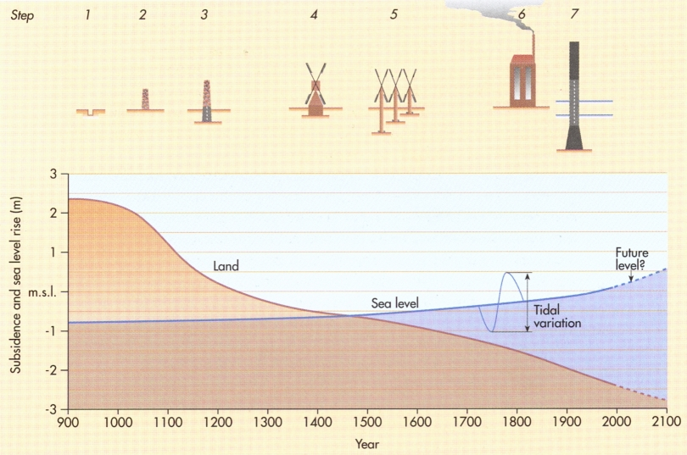
The Challenge
Drained peat and clay soils subside + peat excavation (16^{th &} 17th)
Ice dams (18th and 19th century) and increased river discharges (21st)
- Sea level rise > 1m in 2000 years, 20 cm in the last century
- Spatial planning and environmental issues (latter half of 20th century)

Slide 3
Western Netherlands Water System

Slide 4
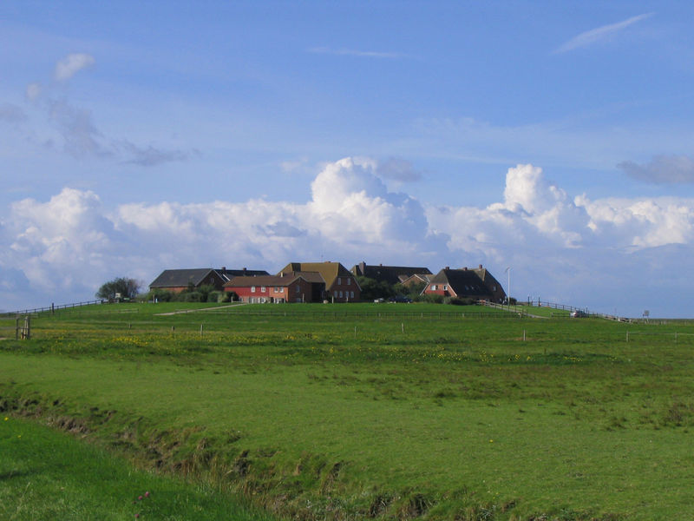

Slide 6
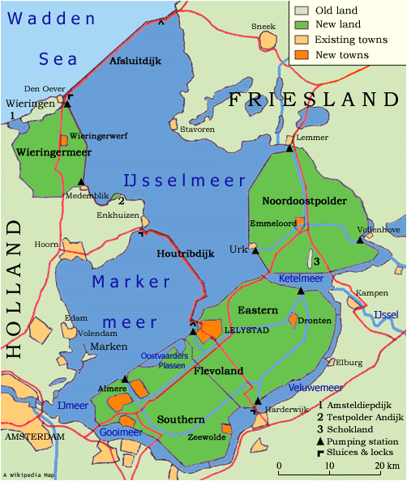
Zuiderzee
Project
INFAMOUS STORM SURGE
FLOODS
1675, 1682, 1916, 1953

Slide 7
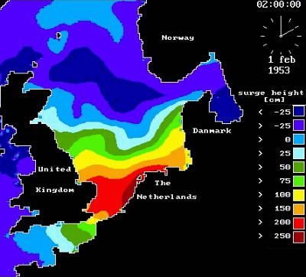
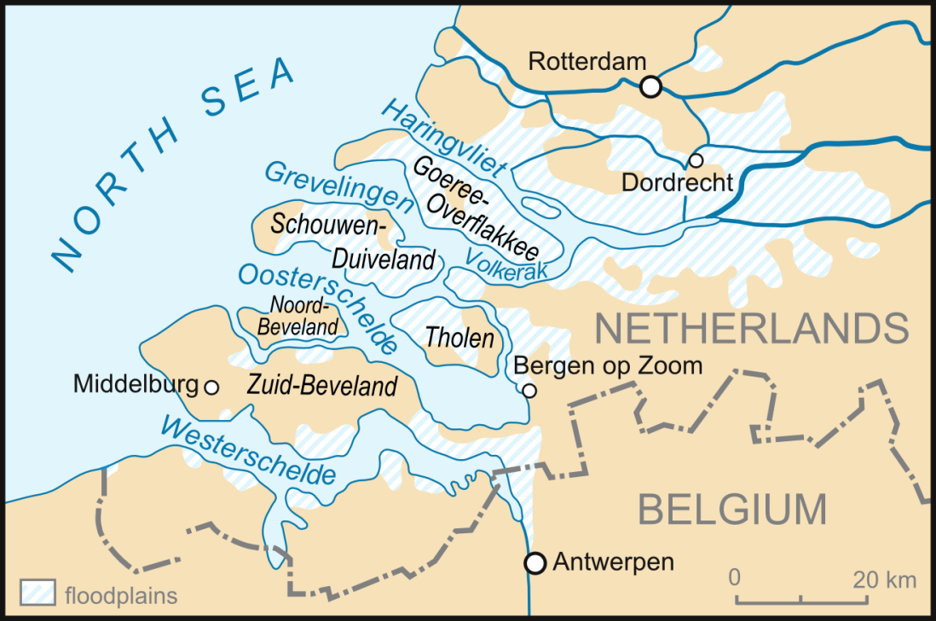
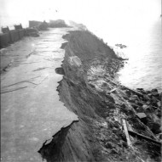
The Great North Sea Storm of 1953
The combination of a high spring tide, and the storm surge reached – 5.6 metres above MLS causing extensive damage and 1838 deaths

Slide 8
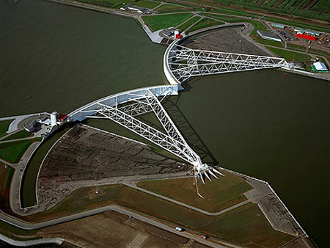
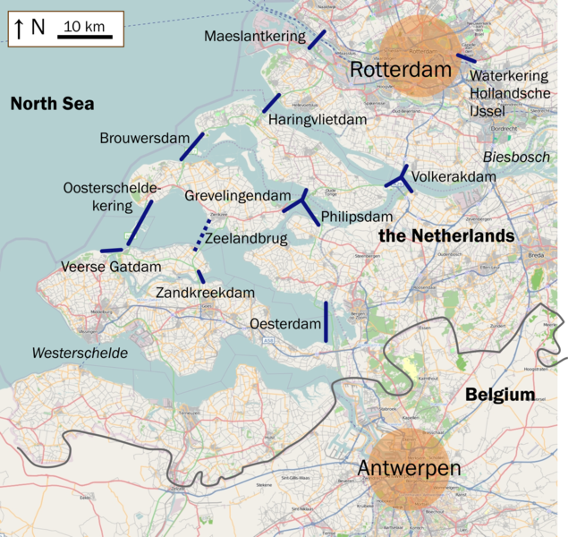
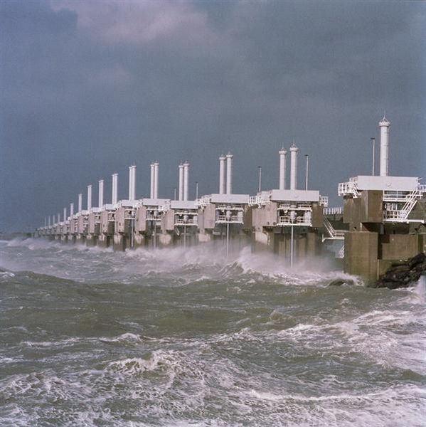
1997
1986
Delta Works

Slide 9
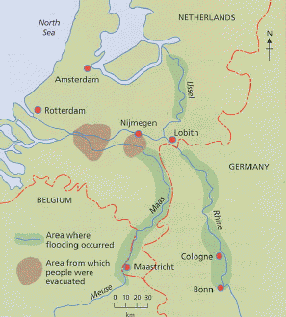
1995 Rhine River Flooding
INFAMOUS RIVER FLOODS
1820, 1876, 1871, 1926, 1995

Slide 10
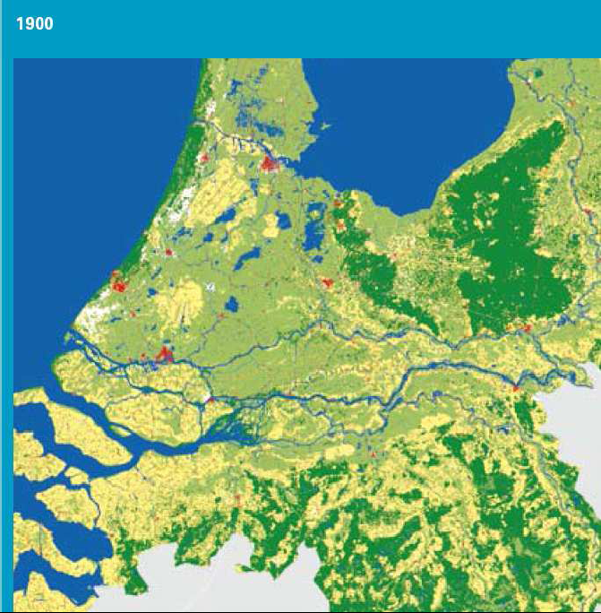
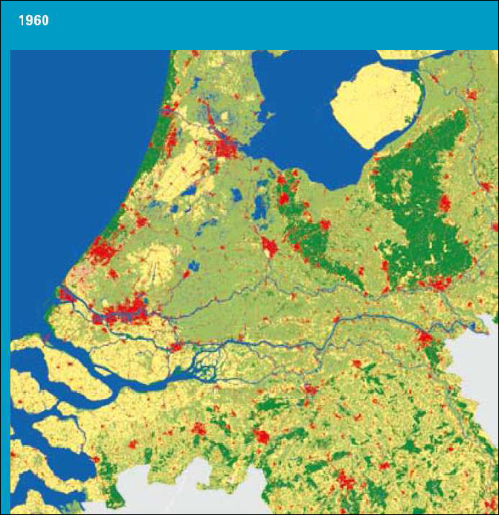
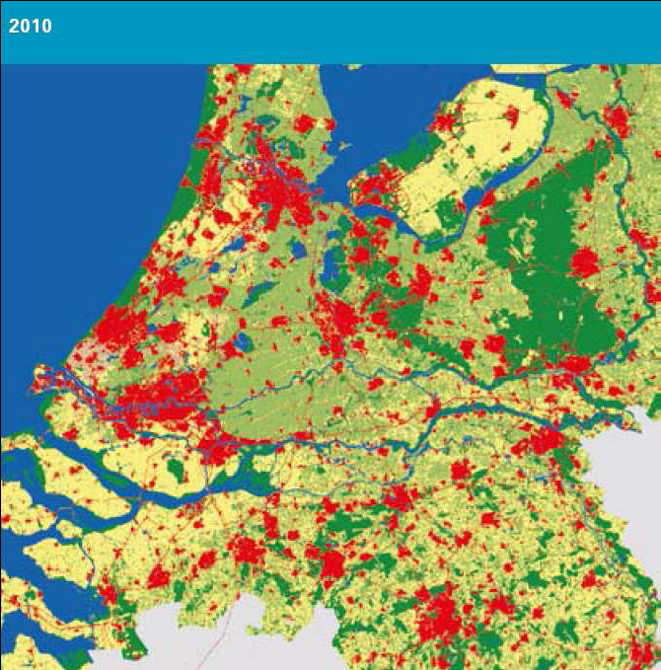
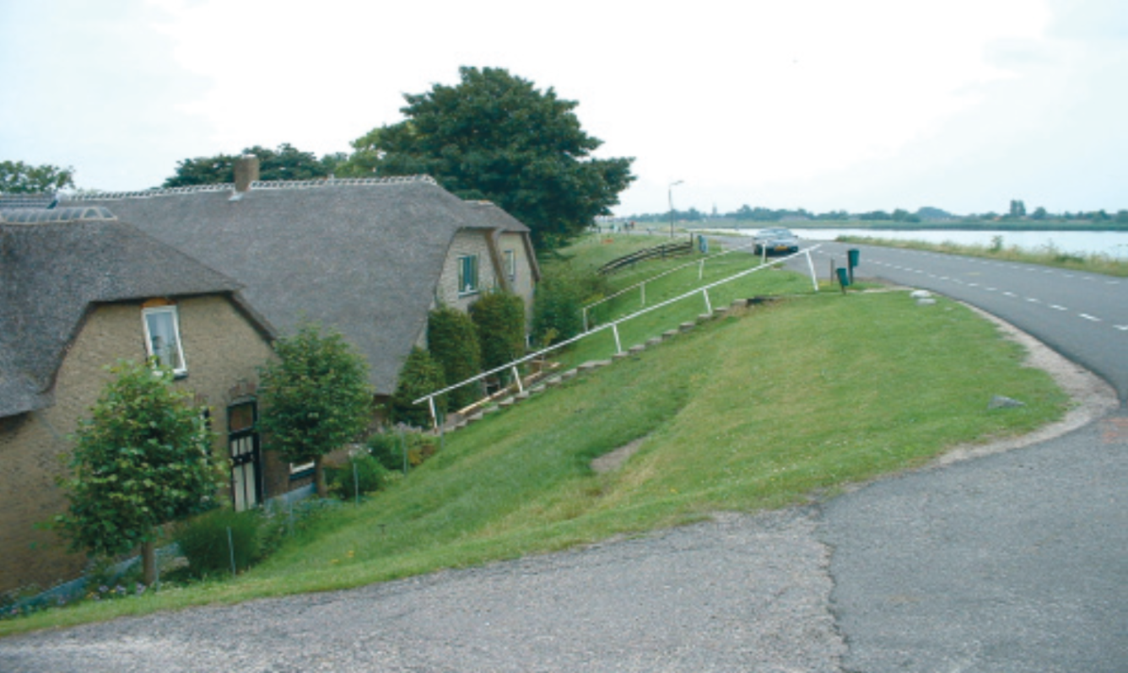
1900
1960
2010

Slide 11
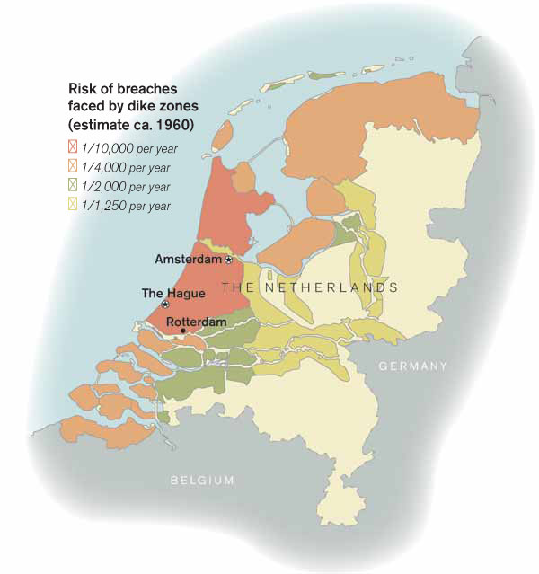
Dutch Safety Standards
Notes:
While many of its comments were general, it did make specific comments about levees in the Midwest noting that there was no system available to coordinate many levees that were being built by nonfederal entities. It also noted thatmany of these nonfederal levees were in poor condition and received very little supervision. It also found that the level of protection provided to urban areas in many cases was less than was needed
11

Slide 12
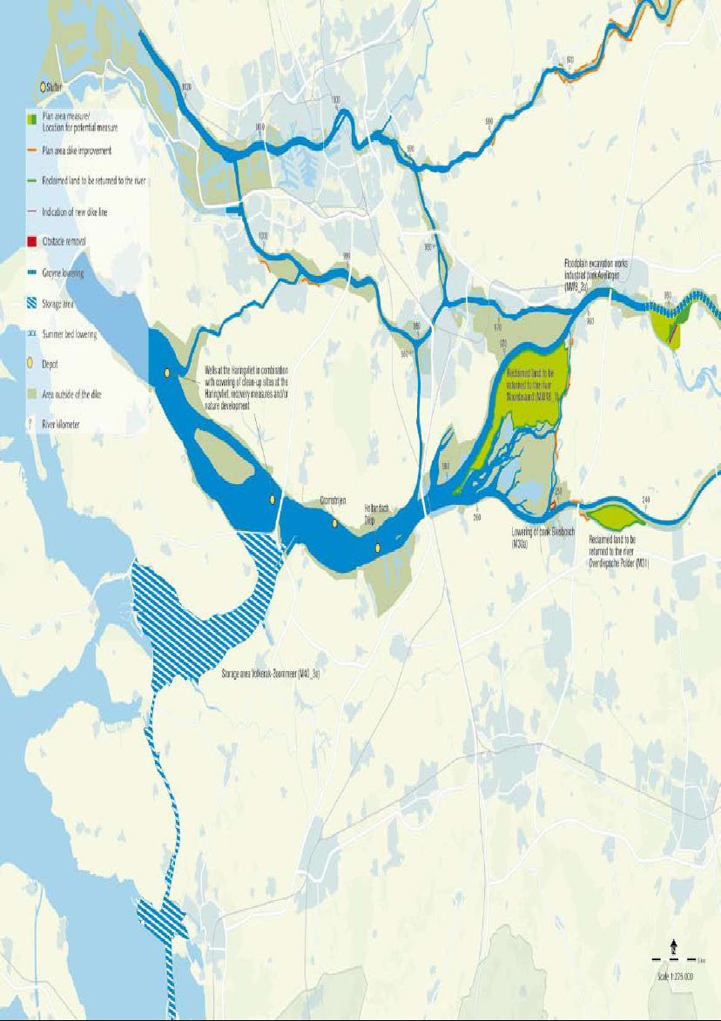
Room for the River

Slide 13
Delta Programme and Delta Model Planning
2011
2012
2013
2014
2015
Deltaprogram
Possible
strategies
Promissing strategies
Preferred
strategies
  Implementation
Deltamodel - 0.2 1.0 1.1
Screening
Subprograms
National
  Delta decisions
DP2013 DP2014 DP2015 DP2016

Slide 14
Delta Model
Three national programmes and six regional programmes
  Safety Standards
  Water Supply
  Spatial Management
Common set of climate change/societal scenario’s, physical models and description of measures
Consistent evaluation of multiple scenario’s and measures for the whole of the Netherlands
Within the time table of the Delta Programme (set by politicians)
Notes:
Vertaling nodig van deze figuur – of stuur origineel
(fresh water supply, new safety standards for flood risk and reconstruction and development)
(Coastal zone, Wadden Sea Area, South Western Delta (Scheldt Delta), the Rhine-Meuse Delta, IJssellake Area and the two major rivers Rhine and Meuse).

Slide 15
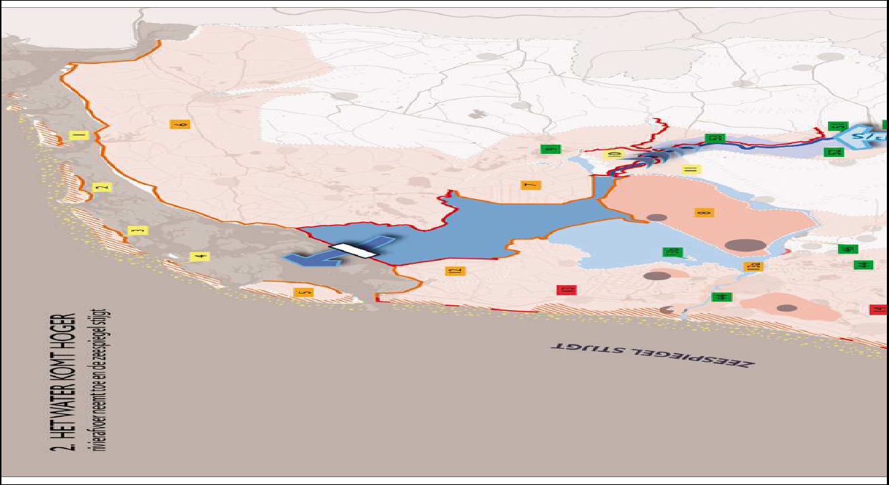
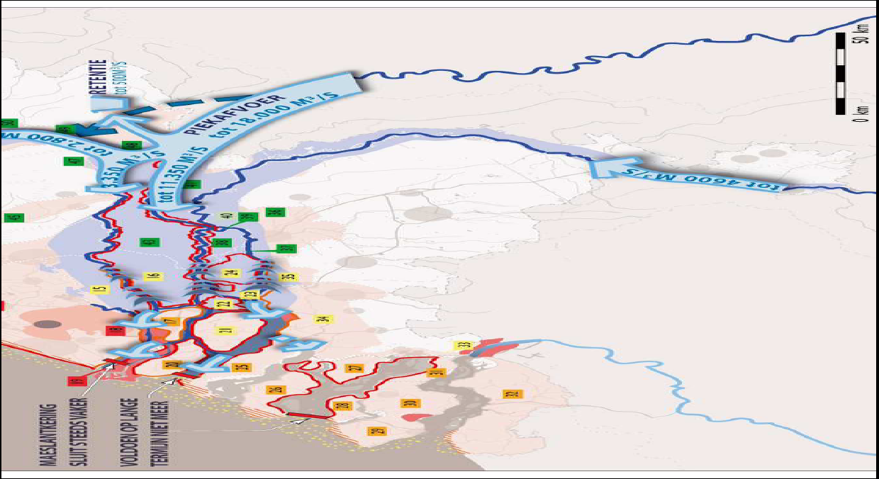
Wetter

Slide 16
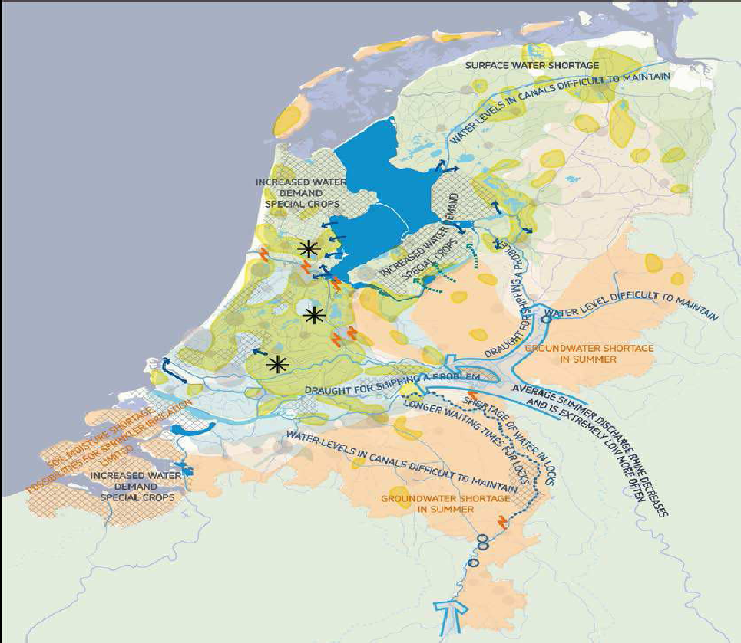
Drier

Slide 17
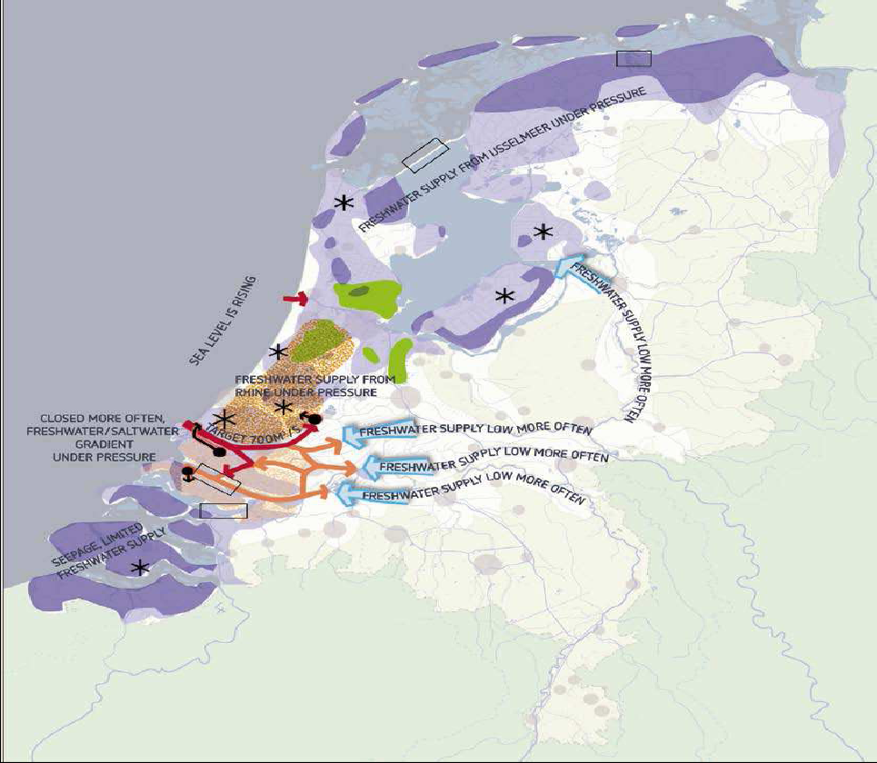
Saline Intrusion

Slide 18
Original Tools
beoordeling
scenario
maatregel
Nieuwbouw
Flood
protection
IJsselmeer
model
ZWDelta
model
model
model
Rijnmond Drechtsteden
Rivieren
Freshwater
model
model
model

Slide 19
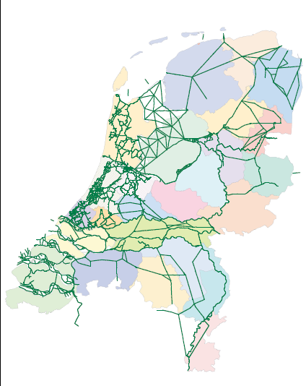
Network
Districts

Slide 20
Deltamodel: Coherent set of models
Deltaportaal
analysis
Computation facility
Deltamodel
scenario
measure
IJsselmeer
ZWDelta
Freshwater
Rivieren
Flood
protection
Rijnmond Drechtsteden
Nieuwbouw
model
model

Slide 21
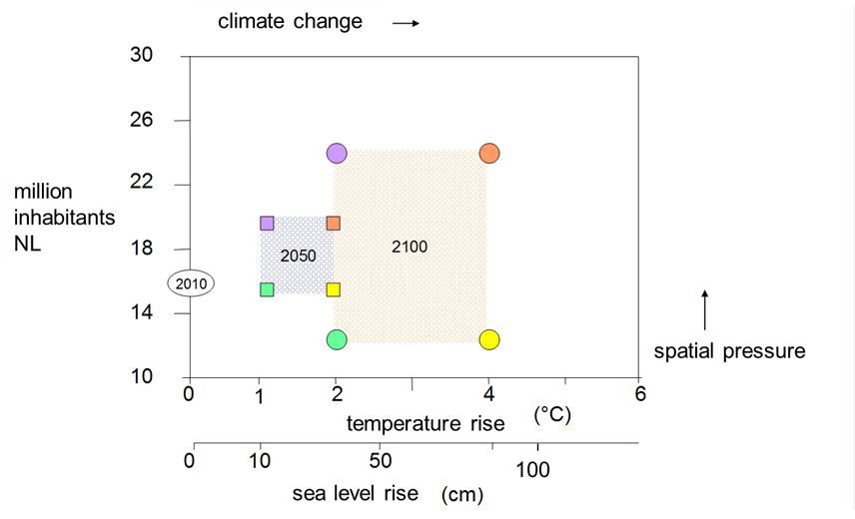
Scenario’s
Determining extremes of climate change and economic conditions

Slide 22
2c. Scenario-analysis
scenario 2100
scenario 2050
reference model
2015
basic model
2010
‘95/’98
2003
calibration
WTI NHI

Slide 23
Change in design water levels : less water over the Lek river & more over the Waal River 2100, W+ scenario

Slide 24
Change in crest levels: less water over the Lek river & more over the Waal River 2100, W+ scenario,

Slide 25
Policy Decision Support
Reference (2015)
Piping / Macrostability / overtopping

Slide 26
Policy Decision Support
2050-Steam; no measures

Slide 27
Policy Decision Support
2050-Steam; measure set X

Slide 28
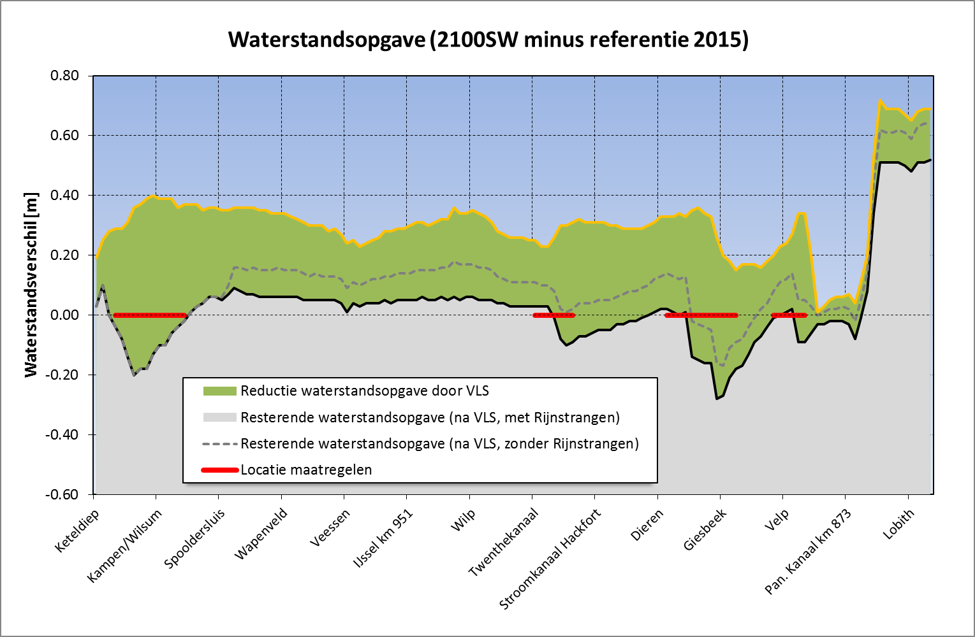
Water Exercise from Ketelmeer to Lobith via the IJssel (2100SW minus REF2015), and their reduction by VLS.

Slide 29
Examples of Choices from Preliminary Data
Replacing the Maeslant barrier around 2070, no locks
- No extra interior barrier dams on river branches in the Rhine-Meuse Estuary
- Pumping (IJssel discharge) instead of discharging through gravity on the IJssellake after 2050
- No pumping of (combined Rhine and Meuse discharge) at the Haringvliet barrier – discharge by gravity is still preferred.
- No emergency river flood storage area on the Eastern Scheldt basin
- No meddling with the discharge over the Rhine Branches

Slide 30
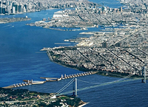
Questions

