Slide 1

Plug-In Electric Vehicles and Grid Integration of EVs
Dr. Alireza Khaligh
Electrical and Computer Engineering Department / Institute for Systems Research
October 20, 2014

Slide 2
OUTLINE:
  Introduction
      Transportation Electrification
      Power Electronics
  Isolated Onboard Level-1 and Level-2 Chargers
        Conventional Chargers
        Maximum Efficiency Point Tracking Technique
  Perspectives for Next Generation of Onboard Chargers
    Parallel Resonant Stage Chargers
    Integrated Chargers
    Vehicle-to-Grid and Grid-to-Vehicle
  Hybrid Energy Storage Systems
  Summary

Slide 3
TRANSPORTATION 1.0
Transportation 1.0:
  Invention of Internal Combustion Engine (ICE), 150 years ago
  Current Statistics:
  Over 900 million vehicles worldwide
  Over 250 million registered vehicles in the U.S.
  50 million vehicles are being manufactured every year
  Recent economic growth in China, India, elsewhere

Slide 4
TRANSPORTATION 1.0
Transportation 1.0:
  Accounts for 40% of GHG and 70% of emissions
  99% Dependence on ONE source of fuel
  Not Sustainable
  Concerns:
  Rising fuel costs
  Economic apprehensions
  National security dreads
  Environmental and public health

Slide 5
SOLUTION: TRANSPORTATION 2.0
Transportation 2.0:
  ELECTRIFICATION
    Hybrid Electric Vehicles (HEVs)
    Plug-In Hybrid Electric Vehicles (PHEVs)
    Electric Vehicles (EVs)
Transportation 2.0: Electrified
Paradigm
ICE Vehicle
HEVs
PHEVs
EVs
Shift
  An Enabling Technology for Electrification:
  POWER ELECTRONICS

Slide 6
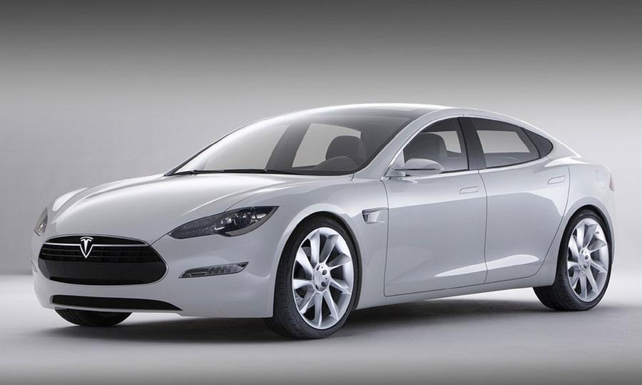
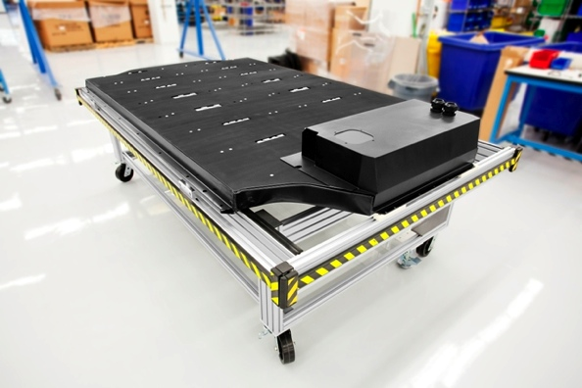
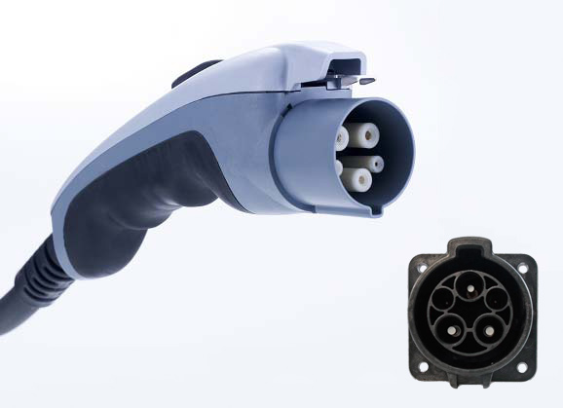
ONBOARD CHARGERS FOR COMMERCIALLY AVAILABLE PEVS
Image source: http://tudo-autos.blogspot.com/2013_12_01_archive.html
Image source: http://www.extremevoltage.it/Articolo_img.php?id=19
Image source: http://netzero-usa.com/home-improvement-products/electric-vehicle-charge-stations/
CHARGING CHARACTERISTICS AND INFRASTRUCTURES OF SOME MANUFACTURED PHEVS AND EVS
Vehicle | EV type | Price | Battery | On-Board Charger | E-Range | Connector type | Level 1 | Level 2
Nissan leaf | EV | $35,200 | 24kWh Li-ion | 3.3 kW OBC | 100 mi | SAE J1772 JARI/TEPCO | 22 hrs | 8 hrs
BWM Active E | EV | Lease Only | 32 kWh Li-ion | 7.2 kW OBC | 100mi | SAE J1772 | 8-10 hrs | 4-5 hrs
Ford Focus | EV | $39.200 | 23 kWh Li-ion | 6.6kW OBC | 76mi | SAE J1772 | 20 hrs | 3-4 hrs
Mitsubishi I | EV | $29,125 | 16 kWh Li-ion | 3.3 kW OBC | 62 mi | SAE J1772 JARI/TEPCO | 22.5 hrs | 7 hrs
Honda Fit | EV | Lease Only | 20kWh Li-ion | 3.3kW OBC | 76mi | SAE J1772 | 6 hrs | 3 hrs
Toyota Plug-in Prius | PHEV | $32,000 | 4.4 kWh Li-ion | 3.3 kW OBC | 15mi | SAE J1772 | 3 hrs | 1.5 hrs
Chevy Volt | PHEV | $39,145 | 16kWh Li-ion | 3.3kW OBC | 35mi | SAE J1772 | 10 hrs | 4 hrs
*Specification data is based on public information and is subject to change.
Notes:
The EMI filter in the power supply line is to prevent conducted noise from the load and it's switching circuit being fed back into the power supply.
Interference (EMI) is unacceptable electromagnetic emissions, natural or man-made, which result in the degradation or malfunction of electronic or electrical equipment.

Slide 7
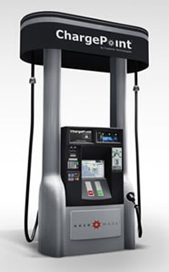
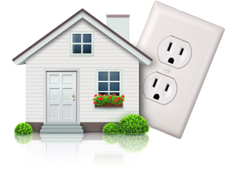
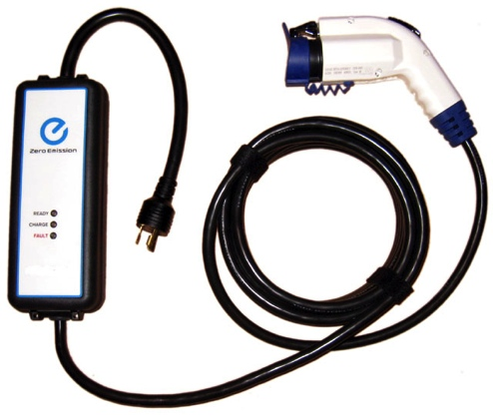
CHARGING POWER LEVELS
Image source: http://stockfresh.com/image/1409468/house-icon
Image source: http://www.planete-citroen.com/forum/showthread.php?p=2204483
Image source: http://www.verdek.com/pdf/news_1-24-2011.pdf
Charging Level | Power Supply | Charging Power | Miles of Range for 1 Hour of Charge | Charging Time
 |  |  |  | BEV | PHEV
Level 1 | 120VAC Single Phase | 1.4 kW @ 12 amp (on board) | 3-4 miles | ~17Hours | ~7 Hours
Level 2 | 240VAC Single Phase Up to 19.2 kW (up to 80 amps) | 3.3 kW (on-board) | 8-10 miles | ~7 Hours | ~3 Hours
 |  | 6.6 kW (on-board) | 17-20 miles | ~3.5 Hours | ~1.4 Hours
Level 3 DC fast Charge | 200 – 450 VDC Up to 90 kW (~200 amps) | >50 kW (off board) | 50-60 miles (~80% per 0.5 hr charge) | 30~45 Mins | ~10 Minutes
Data Source: California PEV Collaborative (CG3-3).
Notes:
Level 2 is the one we use for dryers at home.
The EMI filter in the power supply line is to prevent conducted noise from the load and it's switching circuit being fed back into the power supply.
Interference (EMI) is unacceptable electromagnetic emissions, natural or man-made, which result in the degradation or malfunction of electronic or electrical equipment.

Slide 8
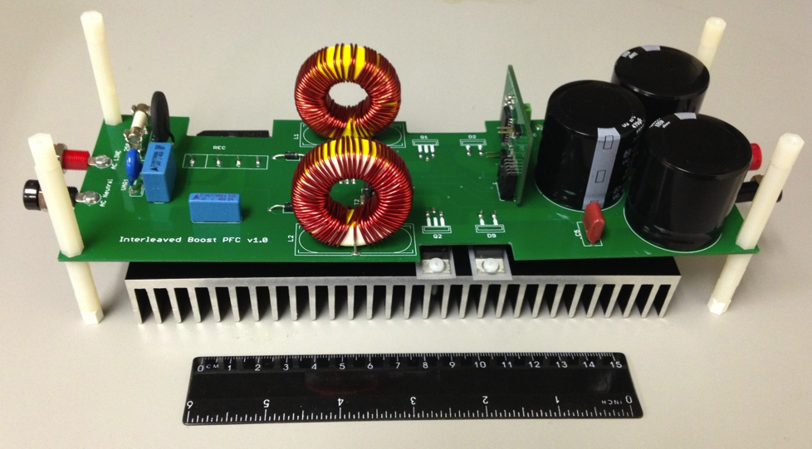
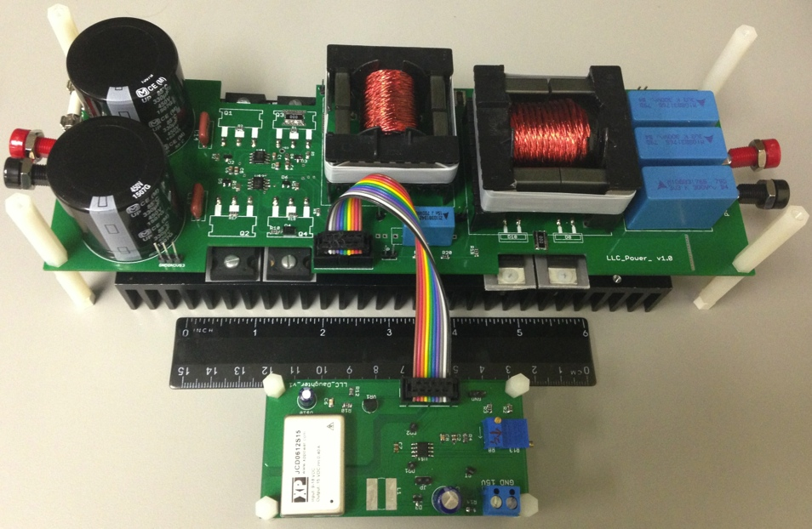
Onboard Isolated Charger
LLC Stage Efficiency Improvement at Full Load: 2.1%
LLC Stage Efficiency Improvement at Light Load: 9.1%
Overall Charger Efficiency Improvement at Full Load: 1.6%
Overall Charger Efficiency Improvement at Light Load: 6.7%
H. Wang, S. Dusmez, and A. Khaligh, “Maximum Efficiency Point Tracking Technique for LLC Based PEV Chargers through Variable DC Link Control,” IEEE Transactions on Industrial Electronics, , vol. 61, no. 11, pp. 6041-6049, Nov. 2014.
Notes:
AC/DC Stage Diode Bridge Si Diodes (GBJ2006-F)
600V, 20A
PFC Stage Boost SiC Diodes (C3D06060A)
600V, 6A
PFC Stage Boost Si MOSFETs (FCP22N60N)
600V, 22A
LLC DC/DC Stage Si MOSFETs (STB23NM60ND)
600V, 20A
LLC DC/DC Stage SiC Diodes (C3D06060A)
600V, 6A

Slide 9
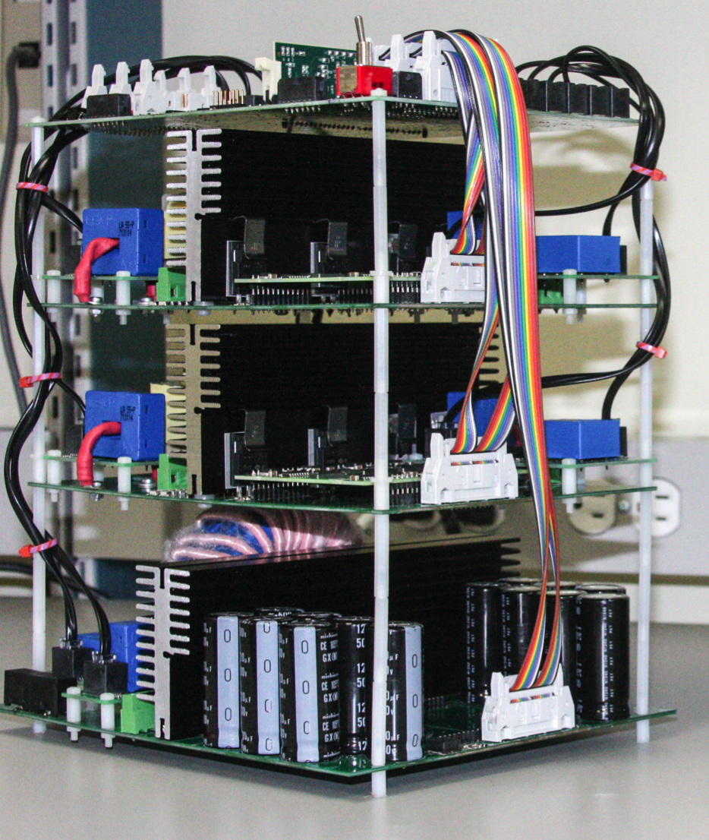
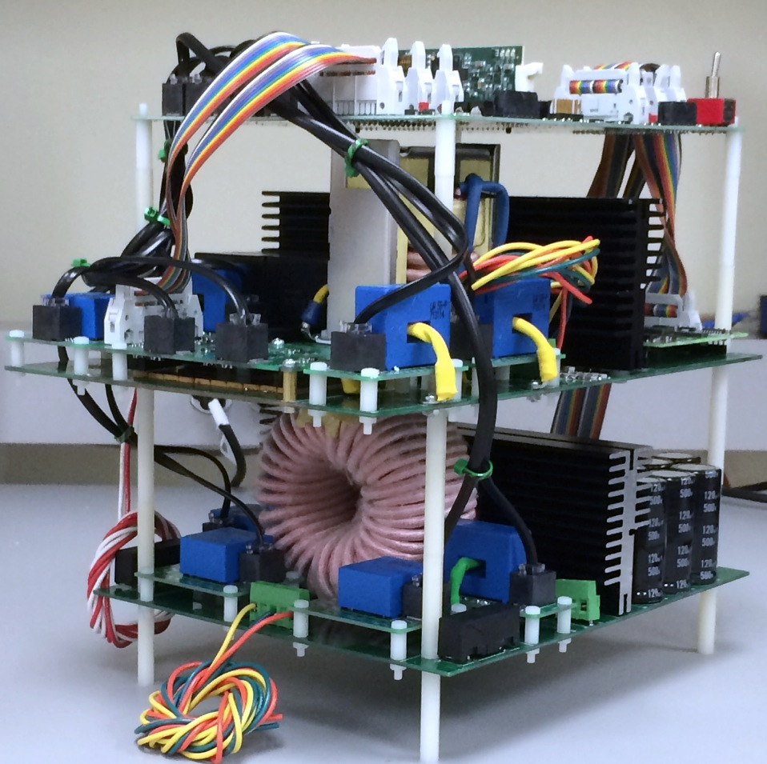
  Perspectives for Next Generation of Onboard Chargers

Slide 10
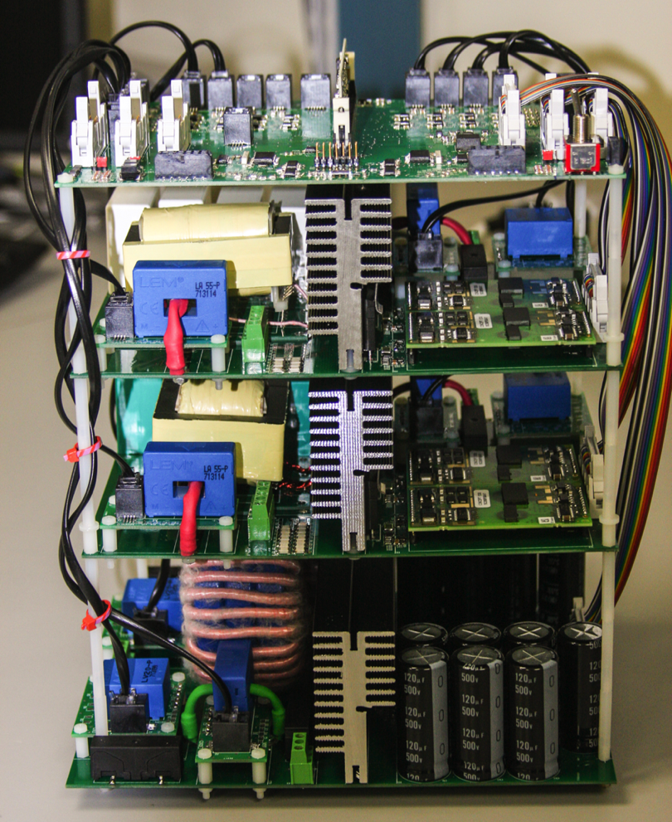
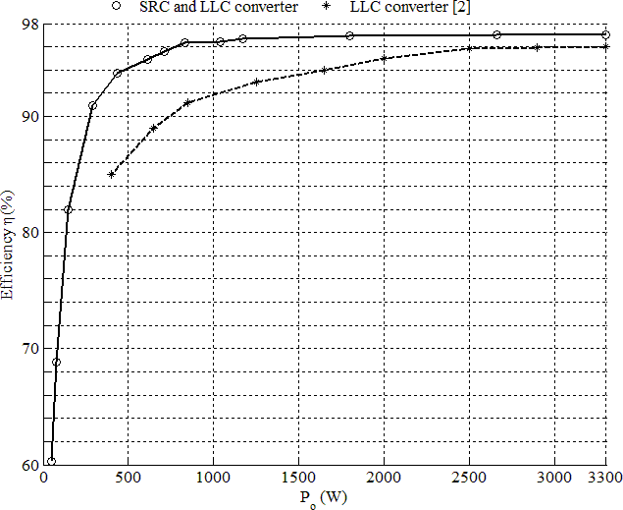
Parallel Resonant Stage Onboard Chargers
Experimental Results
97.3% Efficiency at full load (vs. 96% [2]).
93% Efficiency at 10% of full load (vs. 80% [2]).
[1] A. Khaligh, “A Parallel SRC and LLC Resonant Stage Onboard Charger for Plug-In Electric Vehicles,” under review.
[2] D.S. Gautam, F. Musavi, M. Edington, W. Eberle, and W.G. Dunford, “An automotive onboard 3.3-kW battery charger for PHEV application,” IEEE Trans. on Vehicular Tech. , vol. 61, no. 8, pp: 3466 - 3474, Oct. 2012.
Notes:
DC link Capacitors’ capacitance: 840uF (7 x 120uF) x 2 = 1680 uF

Slide 11
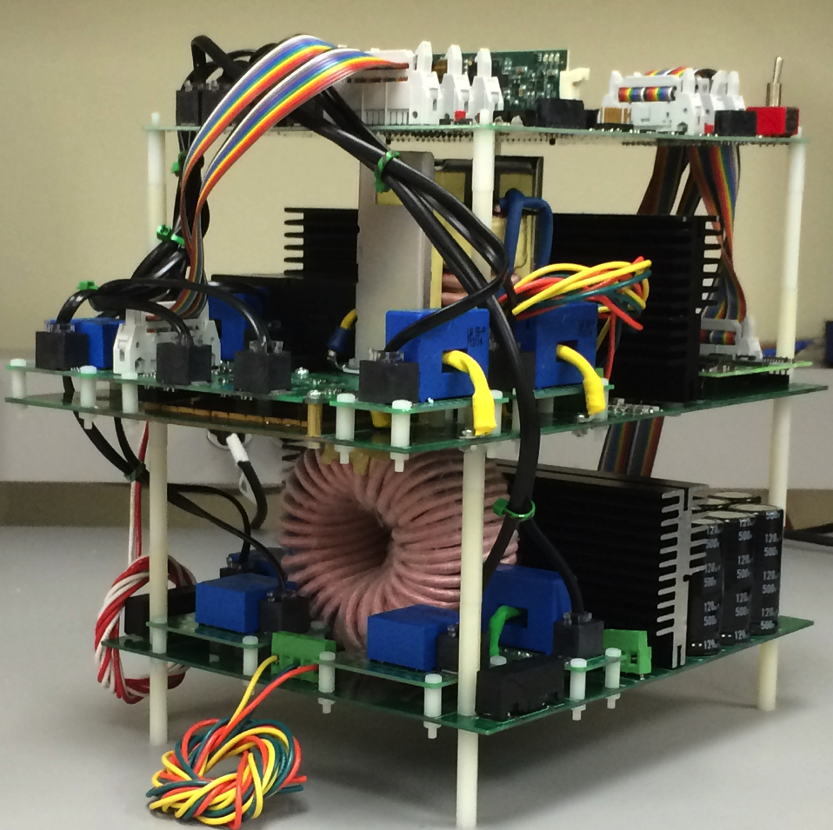
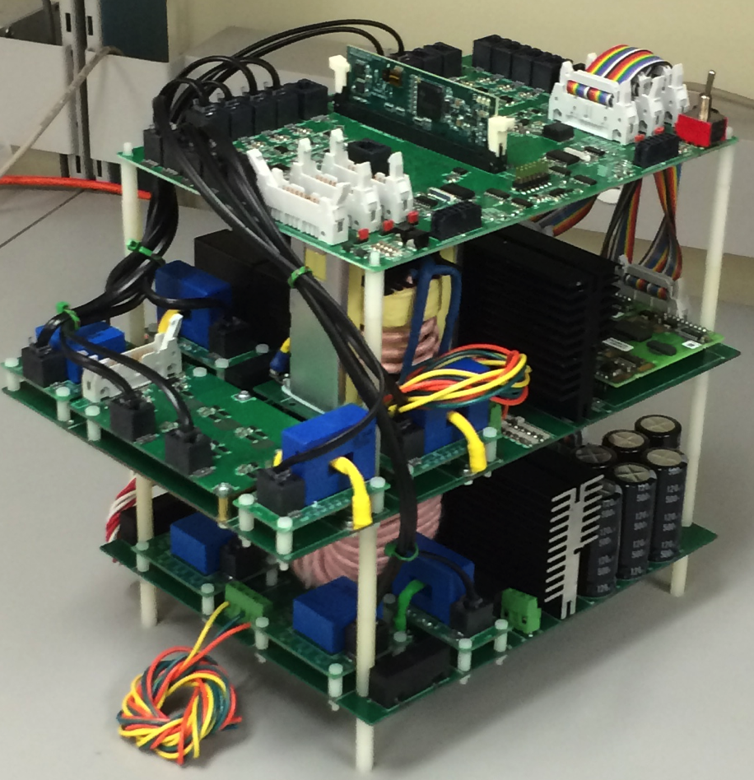
Integrated Bidirectional Onboard Chargers
    A. Khaligh, Integrated Power Electronic Charger for Plug-in Electric Vehicles, University of Maryland Invention Disclosure Number PS-2013-055, Provisional Patent Application No. 62/011649, filed on Jun. 13, 2014
Notes:
The EMI filter in the power supply line is to prevent conducted noise from the load and it's switching circuit being fed back into the power supply.
Interference (EMI) is unacceptable electromagnetic emissions, natural or man-made, which result in the degradation or malfunction of electronic or electrical equipment.

Slide 12
POWER ELECTRONICS @ MARYLAND
  Hybrid Energy Storage Systems for Electric Vehicles and Plug-In Hybrid Electric Vehicles
  A. Khaligh and S. Dusmez, DC/DC Converter for Hybrid Energy Storage System and Method, Pending Patent Application No. 14/179,108, filed on Feb. 12, 2014.

Slide 13
Summary
  Research Activities at the Power Electronics, Energy Harvesting and Renewable Energy Laboratory at the ECE Department of the University of Maryland:
  Integrated and Highly Efficient Power Electronics Interfaces for Transportation Electrification
    Onboard Chargers
    Hybrid Energy Storage Systems

Slide 14

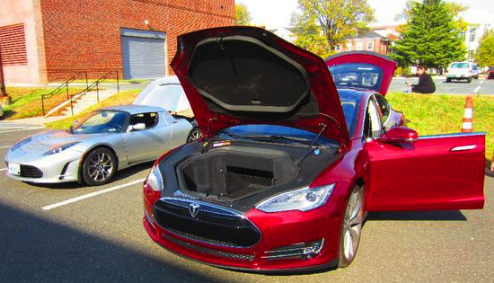
Transportation Electrification @ UMD ECE

