Slide 1
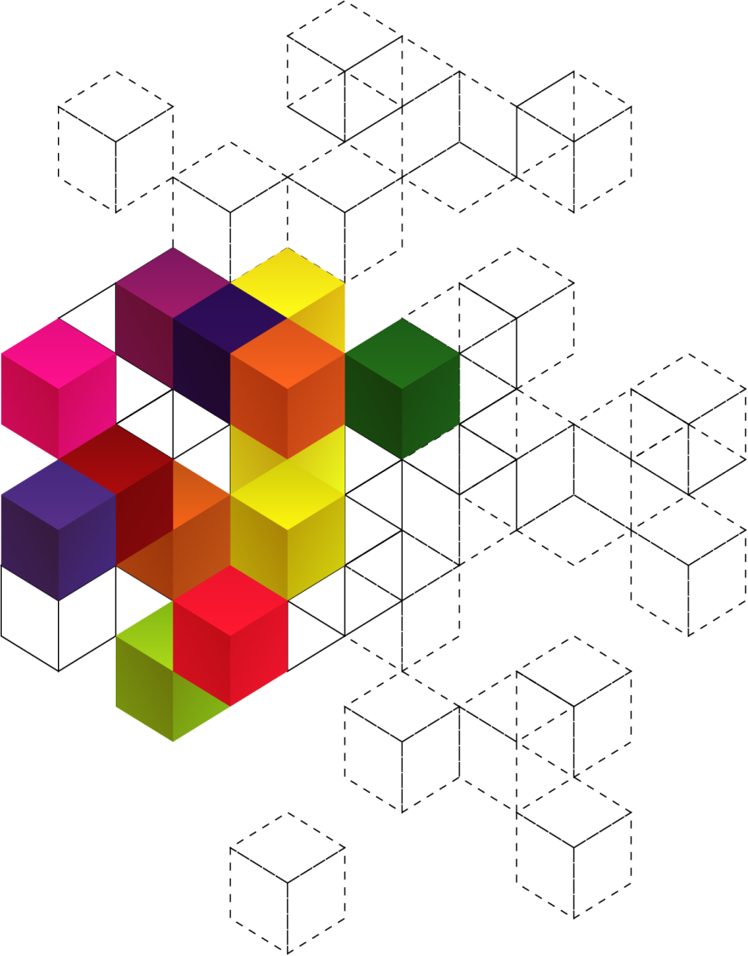
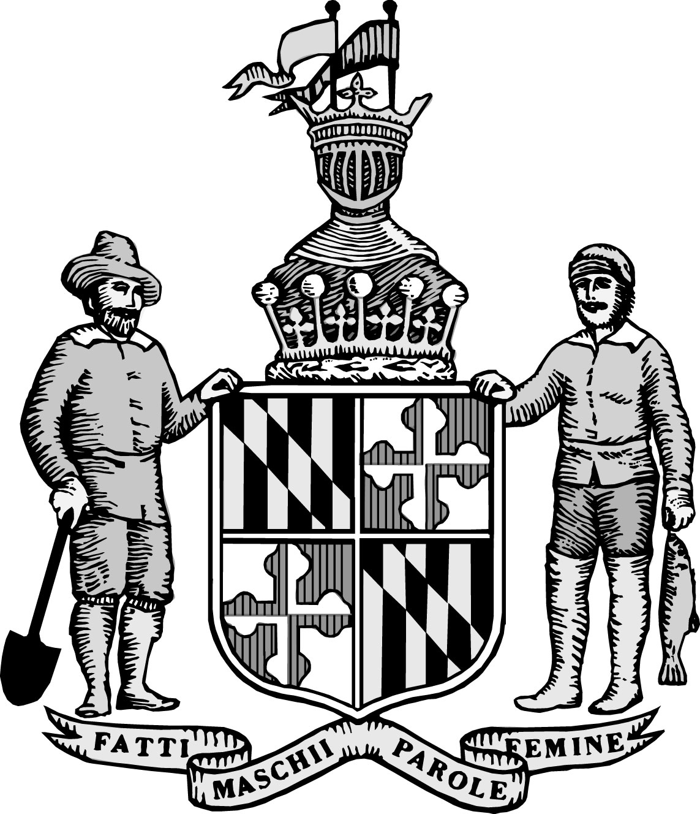
Maryland
RESILIENCY THROUGH MICROGRIDS
Abigail Ross Hopper, Esq.
Energy Advisor, Governor Martin O’Malley
Director, Maryland Energy Administration
October 20,2014

Slide 2
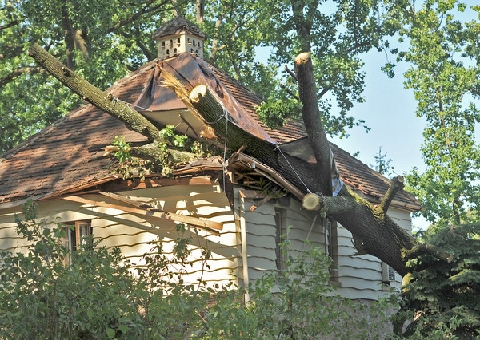
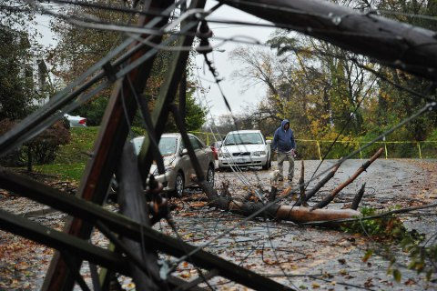
Social Expectations
Marylanders expect reliable electric service, during both blue sky days and major storms, at a low cost.
However, a significant disconnect exists between the public’s expectation of reliability and the ability of the present-day electric distribution system and utility business model to meet those expectations.

Slide 3
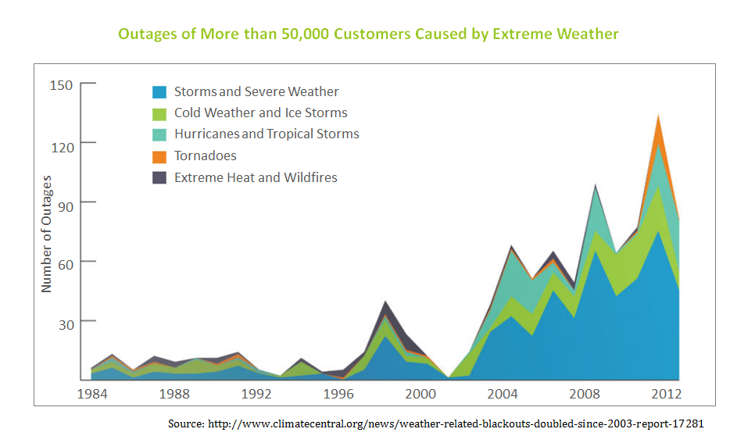
Frequency of Outages
Notes:
Climate Central, a nonprofit organization focusing on the impacts of climate change:
- Tenfold increase in power outages related to extreme weather from the 1980s to 2012
These threats represent a very tangible and quantifiable impact to our safety, comfort and economy
Shows that these events are increasing in severity and occurrence
As we become more reliant on electricity for daily lives, the risk increases
Communication
Heating/cooling
Transportation

Slide 4
Cost of Outages: Maryland
“Snowmageddon” (2010)
Interruptions: BGE: 142,228; Pepco: 251,769; PE: 12,478
Hurricane Irene (2011)
Interruptions: BGE: 756,395; Pepco: 410,313; PE: 19,702
Derecho (2012)
Interruptions: BGE: 762,781; Pepco: 958,563; PE: 90,467
Estimated cost of three storms to customers:
$1.1 billion
Notes:
Climate Central, a nonprofit organization focusing on the impacts of climate change:
- Tenfold increase in power outages related to extreme weather from the 1980s to 2012
These threats represent a very tangible and quantifiable impact to our safety, comfort and economy
Shows that these events are increasing in severity and occurrence
As we become more reliant on electricity for daily lives, the risk increases
Communication
Heating/cooling
Transportation

Slide 5
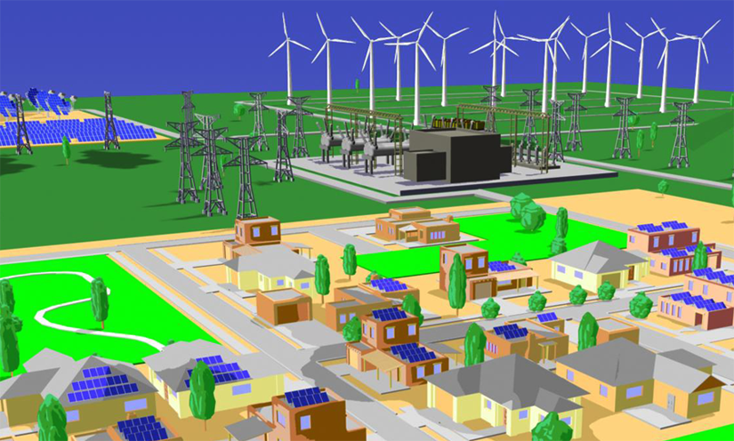
A New Paradigm: Microgrids
Tree limbs falling on power lines cause the majority outages during severe weather events.
But what if we can generate electricity closer to where it is consumed?
With technological innovation, it is becoming increasingly viable to do this economically.

Slide 6
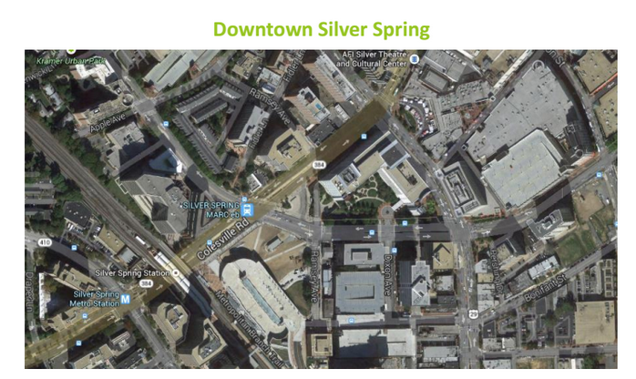
Public Purpose Microgrids
Grocery store
Government building
Hardware store
Restaurants
Movie theater
Metrorail
Bus station
NOAA
Serve critical community assets across multiple properties
Critical community assets are community centers, commercial hubs, and emergency services
Notes:
Public Purpose Microgrids are a particular type of Microgrids Maryland is interested in.
Services:
-Food, water, etc.
-Communication device charging
-Rally point/shelter in emergencies
-Emergency response
-Etc.
Downtown Silver Spring
-Used as an example in the report
-Has government services, grocery store, shopping center, etc

Slide 7
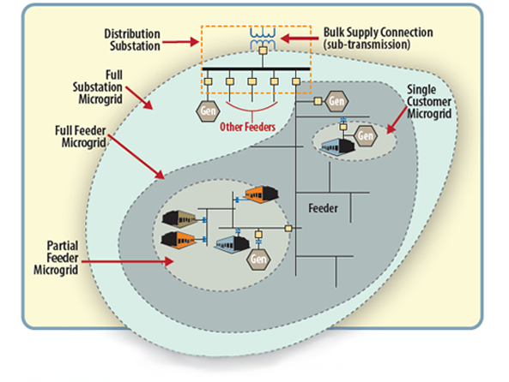
The Next Step: Multiple Customers and Properties
From a technical and regulatory standpoint, microgrids servicing single customers on single properties are feasible – and exist – in Maryland today.
Now we’re looking at the next step in deployment: systems that cross public rights of way to serve multiple customers.

Slide 8
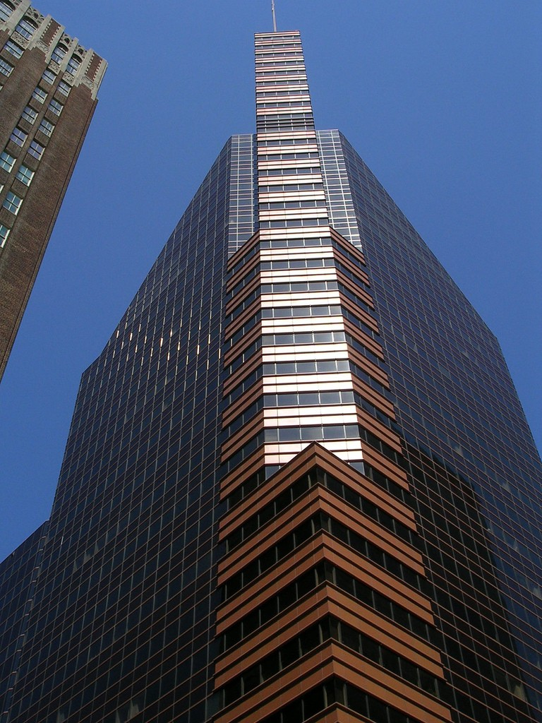
Short Term: Utility-Owned Public Purpose Microgrids
Current Maryland law provides a framework for the deployment of utility-owned and/or operated public purpose microgrids.
The Task Force assembles the pieces of the puzzle necessary for the deployment of these systems in Maryland, but PSC approval is necessary.

Slide 9
Maryland
RESILIENCY THROUGH MICROGRIDS
Abigail Ross Hopper, Esq.
410-940-9071 (cell)
abigail.hopper@maryland.gov
October 20,2014

